Slide 1
Report of 2023 Activities
March 28, 2024

Slide 2
Our Mission is to Promote:
The development and use of renewable and clean energy technologies;
Energy conservation and efficiency;
Sustainable energy businesses;
And projects that improve the environment in the Metropolitan Edison Company/Pennsylvania Electric Company service territories, as they relate to the companies’ transmission and distribution facilities.

Slide 3
2023 Advisory Committee
Mr. Davitt Woodwell (Chair) | Rep. Environmental
Mr. Brian Hill (Vice Chair) | Rep. At-Large
Ms. Jennifer Schade | Rep. Commercial Customers
Mr. B. Tucker Schreiber | Rep. Industrial Users
Ms. Kelli Volkomer | Rep. Electricity Suppliers
Mr. Dave Vollero | Rep. Independent Power Producers
Ms. Beverly Weaver | Rep. Weatherization
Mr. Chris Wehr | Rep. FirstEnergy

Slide 4
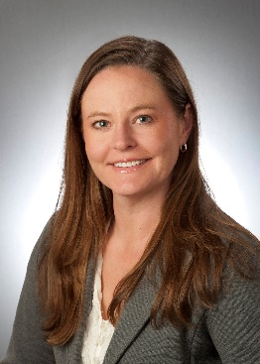
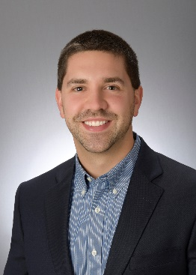
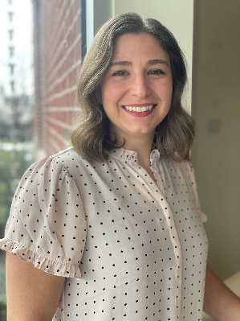
Staff
Angie Berzonski
George Bivens
Penelec Sustainable Energy Fund
Community Foundation for the Alleghenies
Emily Smedley
Met-Ed Sustainable Energy Fund
Berks County Community Foundation
Dave Edinger
Pennsylvania Public Utilities Commission

Slide 5
2023 Approvals
From January 1, 2023 – December 31, 2023, the funds approved $618,202 in total financing.

Slide 6
2023 Financing
ORGANIZATION | PROJECT | AMOUNT
Green Building Alliance | Sustainable Communities | $376,539
Generation 180 | Solar for All Schools | $124,300
Indiana County Conservation District | Solar Installation | $117,363*
*Utilizing Alternative Compliance Payments

Slide 7
Since Inception
Combined, the Met-Ed/Penelec SEF has approved:
279 grants totaling $7,209,518
51 loans totaling $25,161,087
3 equity investments totaling $1,600,000
Initial Gift Total: $14,600,000
Approved Financing Since Inception: $33,970,605
6/30/23 Total Fund Balance: $16,104,672

Slide 8
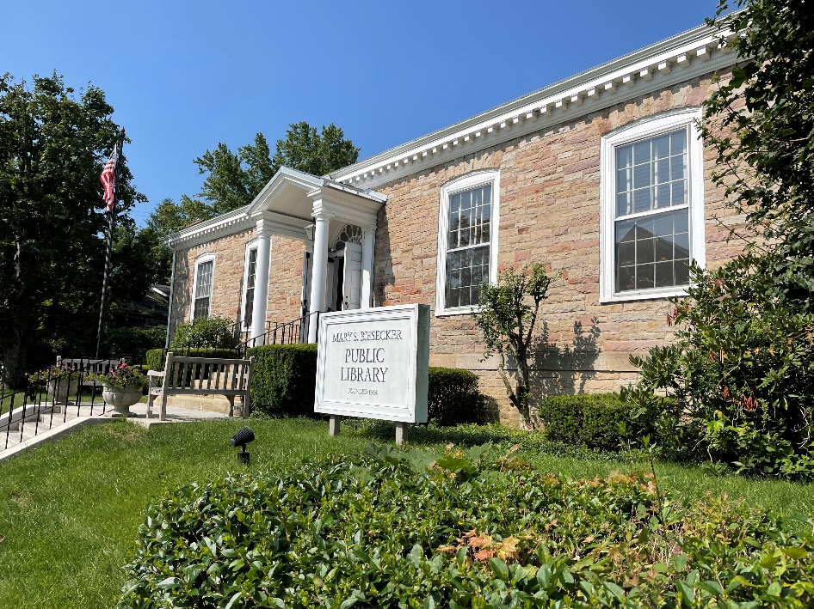
Spotlight Project – Penelec
Mary S. Biesecker Public Library Solar Parking Canopy
$25,000 grant
To support the installation of a 30 kW solar array
Anticipate offsetting 100% of library’s electric consumption plus redirecting excess to EV charging

Slide 9
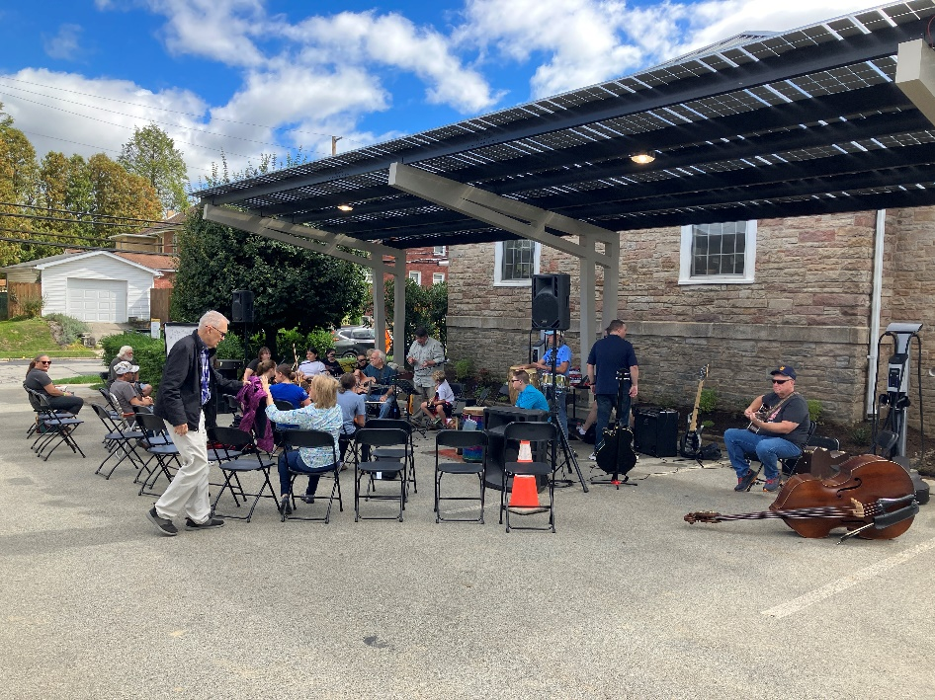
Spotlight Project – Penelec
Mary S. Biesecker Public Library Solar Parking Canopy
Total Solar Generation: 29,924 kWh
Real-Time Consumption: 12,995 kWh
Offset from Grid: 9,038 kWh
Banked for 2024: 7,891 kWh
Redirection of $3,524 to support library’s mission

Slide 10
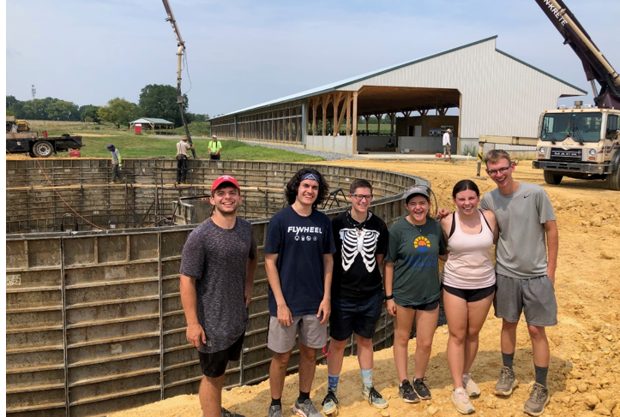
Spotlight Project – Met-Ed
Anaerobic Digestor at Dickinson College Farm
$50,000 grant to support building a commercial anaerobic digestor to generate renewable electricity at a scale appropriate for the average Pennsylvania Dairy Farm.

Slide 11
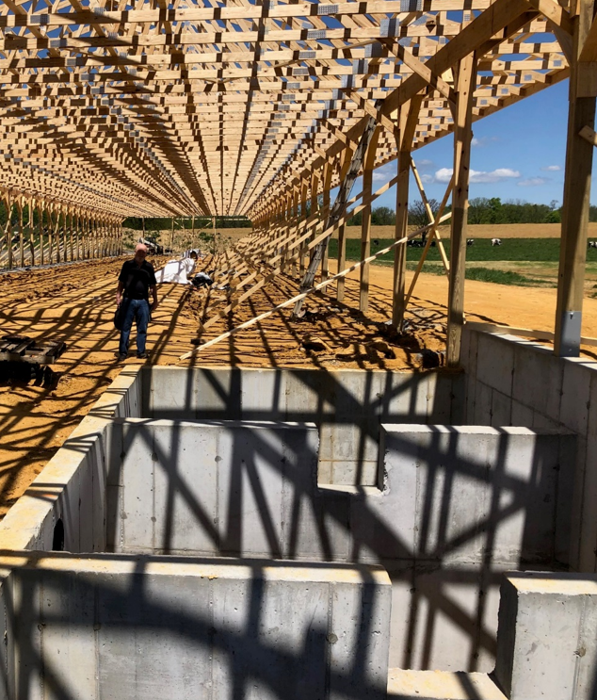
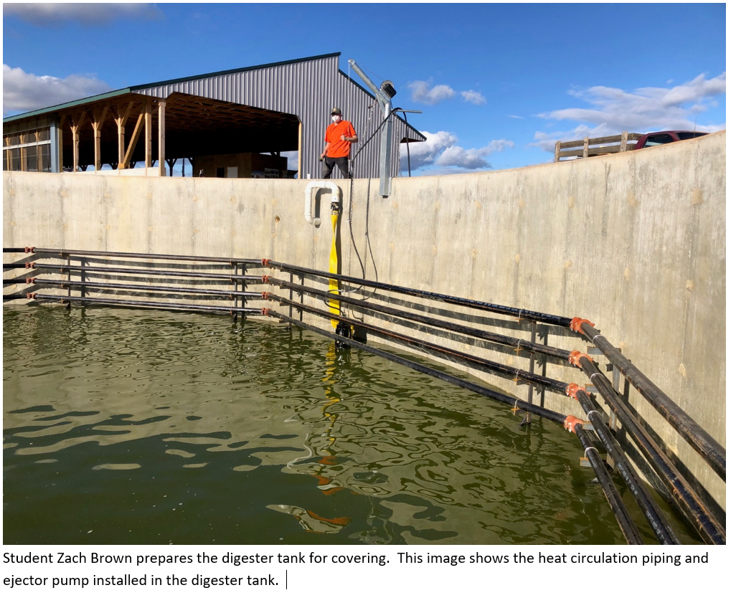
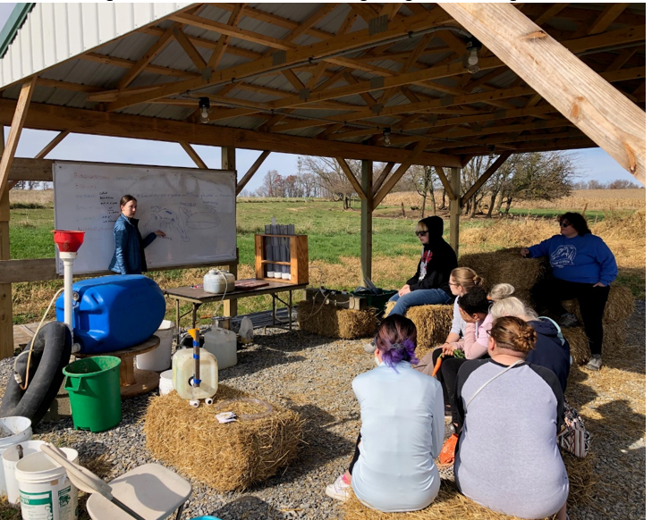

Slide 12
2024 Strategic Planning & Priorities
Throughout 2024, the Fund will strive to fund the following priority areas:
Promote and/or enhance community resiliency, sustainable energy communities and buildings, and microgrids.
Install solar arrays at schools and educational institutions
Benchmark to improve programs, policy, building codes and other avenues for advocacy.
Previously sought to install solar panels on warehouses but changed priorities to focusing on schools and educational institutions. In 2023, approved two-year grant to Generation180 to jumpstart this work.

Slide 13
2024 Fund Strategies
Program Related Investments (PRIs)
Funding for projects focused on sustainable energy technologies, energy efficiency, and conservation.
Offering loans from ~$50,000-$100,000 with a 4-6% interest rate and a maximum 10-year payback period.
Goal is to approve at least two projects in 2024.
Approved first loan to Indiana County Conservation District in 2023 for solar panel array using ACPs.
Grantmaking in Priority Areas
Engage expert consultants and technical service providers to further define the priority areas, design scopes of work, and develop requests for proposals to solicit funding requests as needed.
In 2023, made multi-year grants to Generation180 and Green Building Alliance.

Slide 14
2024 Fund Strategies
Grantmaking in Priority Areas
Generation180: Two-year grant totaling $253,000 to support its Solar for All Schools campaign in the Met-Ed and Penelec territories.
Green Building Alliance: Three-year grant totaling $1.7 million to create a network of sustainable, resilient, and thriving communities across the Met-Ed and Penelec territories using the 2030 District framework.

Slide 15
www.metedpenelecsef.org
March 28, 2024

