Slide 2
Focus
Mission elements
Promote use of renewable and clean energy technologies
Promote energy conservation & efficiency
Promote education, economic development, and environmental benefit of renewable/ clean energy use and energy conservation/ efficiency (three E’s)
Notes:
5013c, corporate home in Greensburg at EGC, day-to-day operations out of State College

Slide 3
Activity Snapshot

Slide 4
Some 2023 Project Commitments
Green Building Alliance 2030 District (New Ken., $95,000)
Republic Food Enterprise Center (LED lighting, $32,000)
Audubon Society Western PA (solar, induction cooking $146,766)
Lutheran Home at Kane (HVAC controls/ campus exp. $100,000)
St Vincent College (Solar EV charging $30,000)
Fayette County Cultural Trust (ASHRAE Audit, $14,500)
American Legion – Centre Hall (solar PV, $30,000)
FCCAA Beeson Homes (Zero Energy Ready, $50,000)

Slide 5
Some 2024 Project Commitments
Clearwater Conservancy - Central PA (Campus Rebuild $40,000)
Centre County Recycling (Solar PV, $75,000)
Geisinger Health Foundation (Solar PV, $75,000)
Saint Vincent College (Induction Cooking $25,000)
Nonprofit Dev. Corp. (Construction & workplace programs, $30,000)
Food Helpers (Solar PV farm expansion, $25,000)
Kane Historic Pres. Soc. (ASHRAE audit implementation, $25,000)
Keystone Elk Country All. (Energy conservation outreach, $170,000)

Slide 6
Striving for Broader Impact
WPPSEF is nurturing projects to have a broader impact, we seek a broader impact
Wholistic approach, collaboration between partners/ projects, buy-local/ hire local, multiple mission facets
Two clusters to be showcased
Six&Kane (Kane, PA)
Wesley Family Services (New Kensington, PA)
Notes:
Multiple investments
Kane/ PA Wilds: Kane Radio, Community Center, Lutheran Home, Kane Chamber, PA Wilds Media Lab, KECA campus expansion, Kane Historical Society
New Kensington: The Corner, Penn State New Kensington, WFS, GBA (EGC – Digital Foundry)

Slide 7
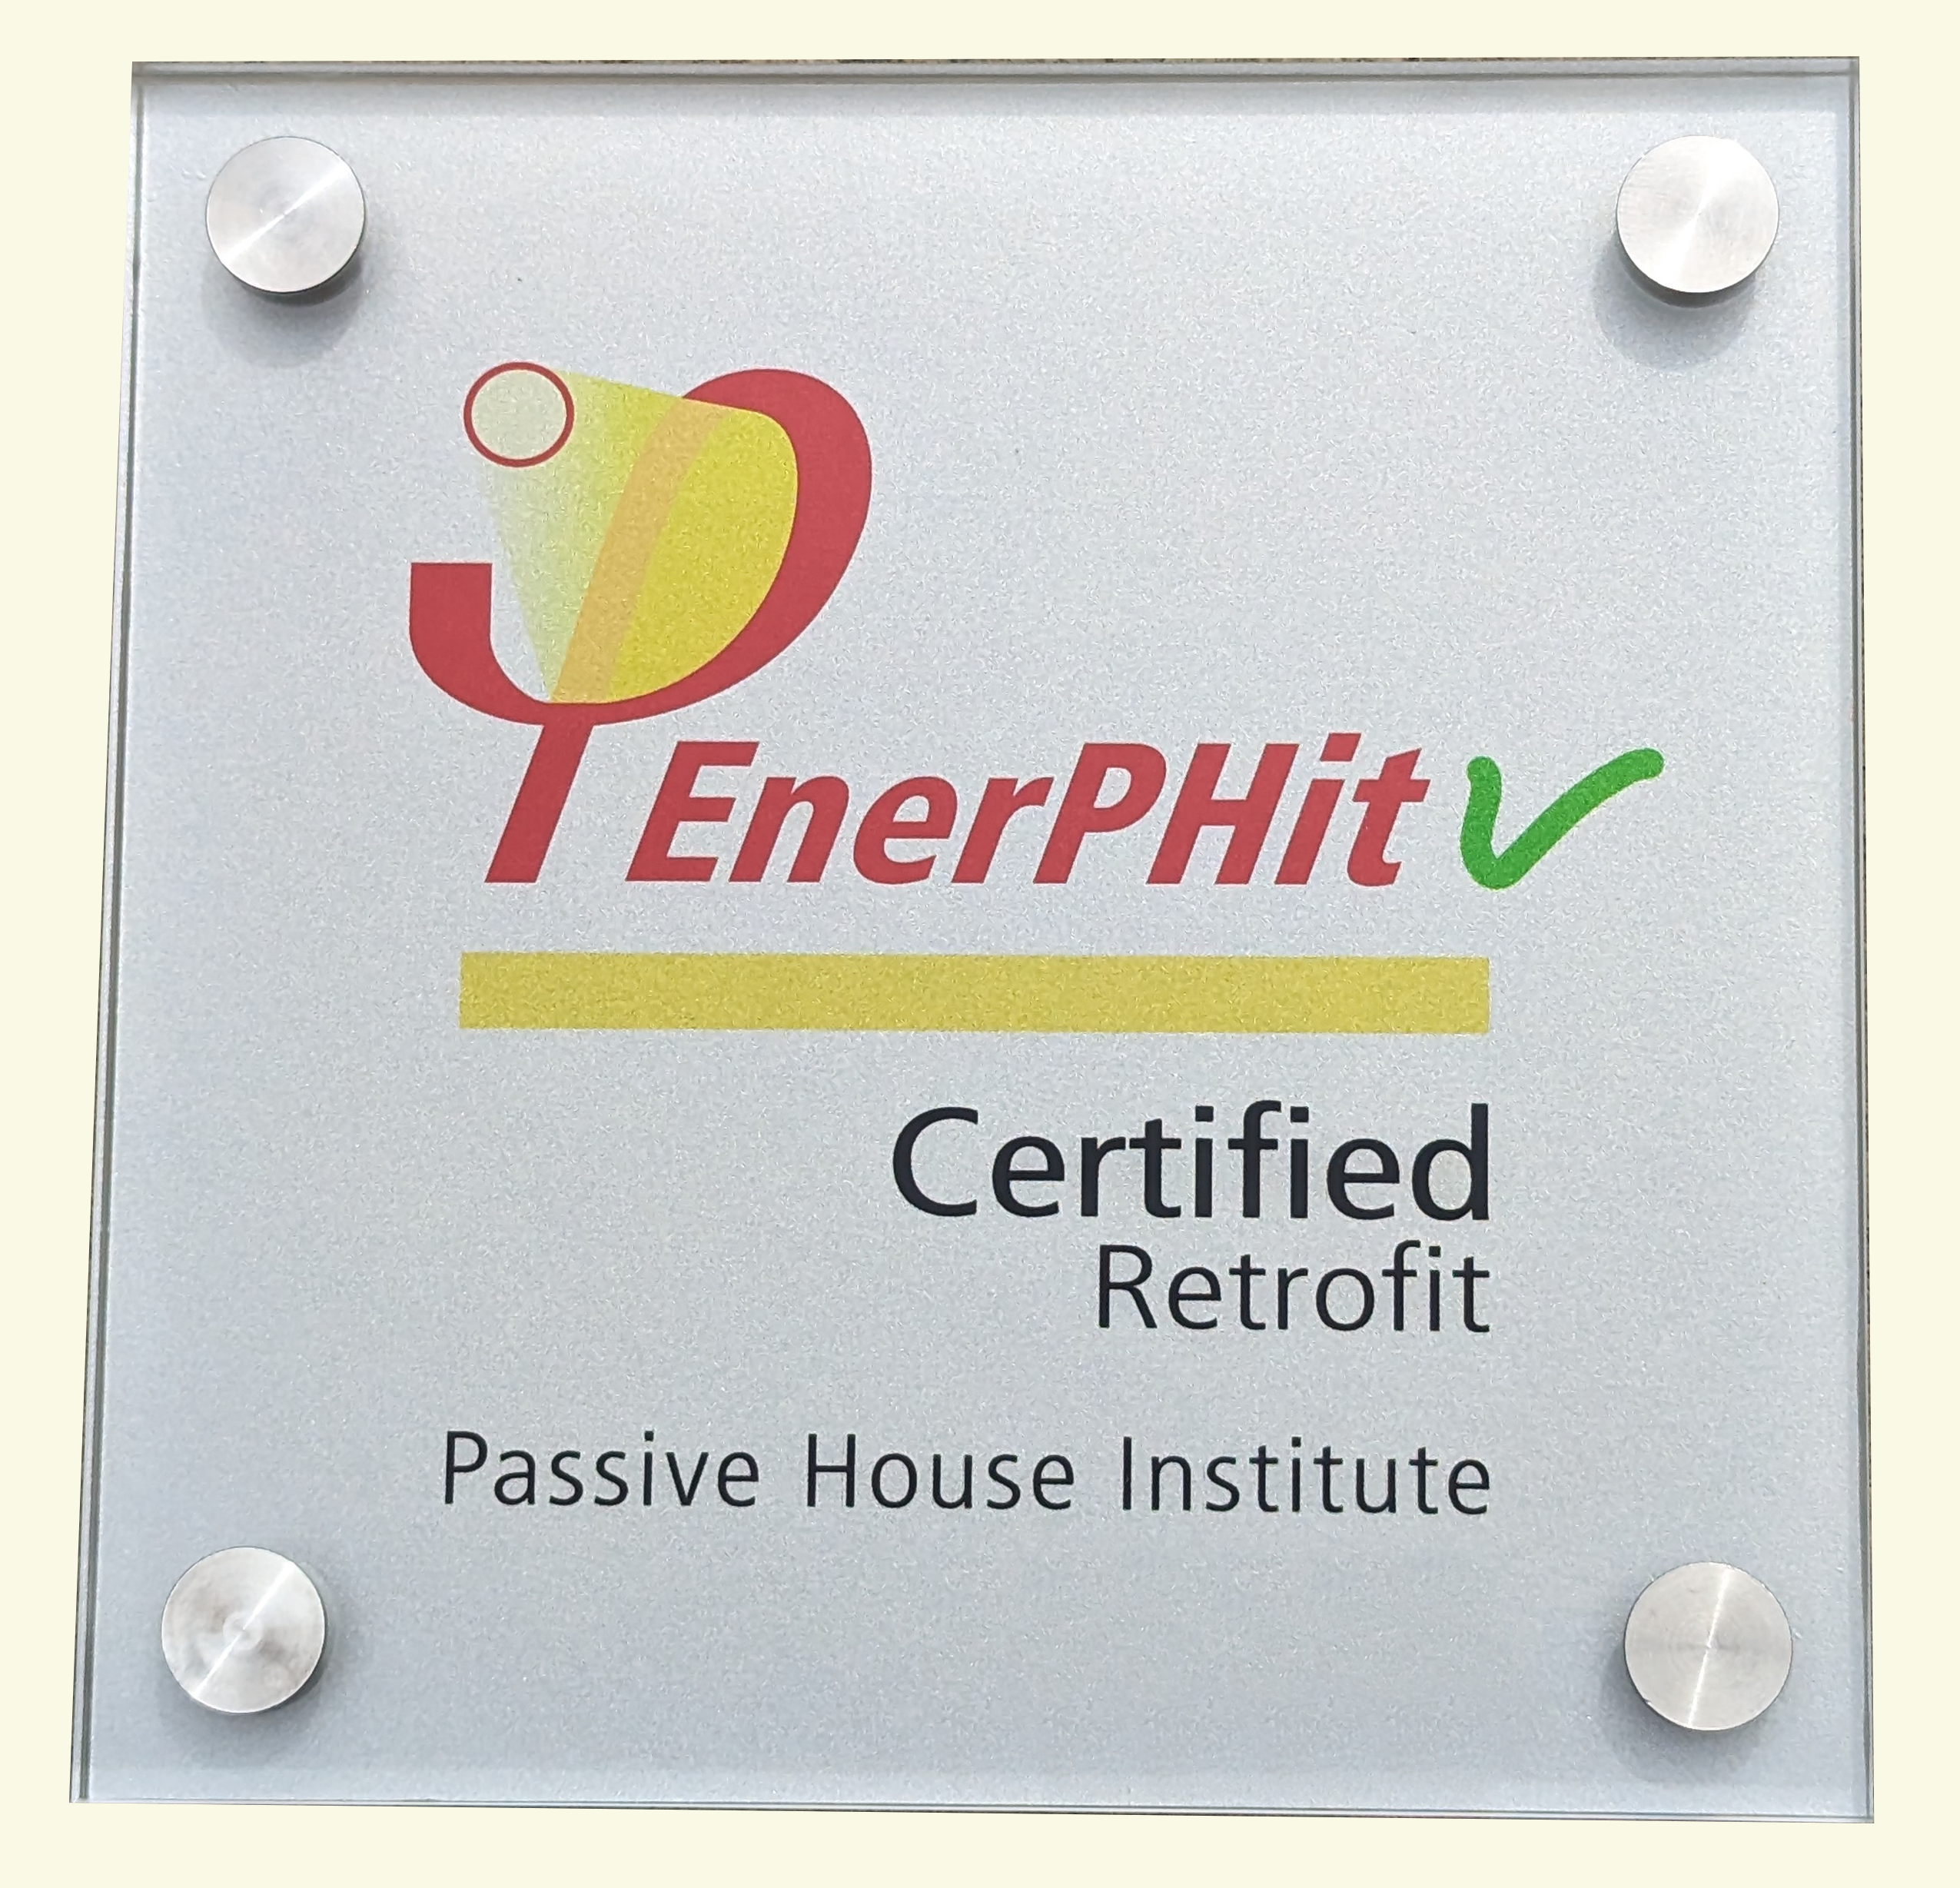
Purchase/ gut-demo: July-Dec. 2019
Passive House Design: January-June 2020
Rebuild: July 2020-Sept. 2022
Occupancy Permit: Sept. 2022
Dedication/ Ribbon Tying: Oct. 7-8, 2022
Certification: March 24, 2023

Slide 8
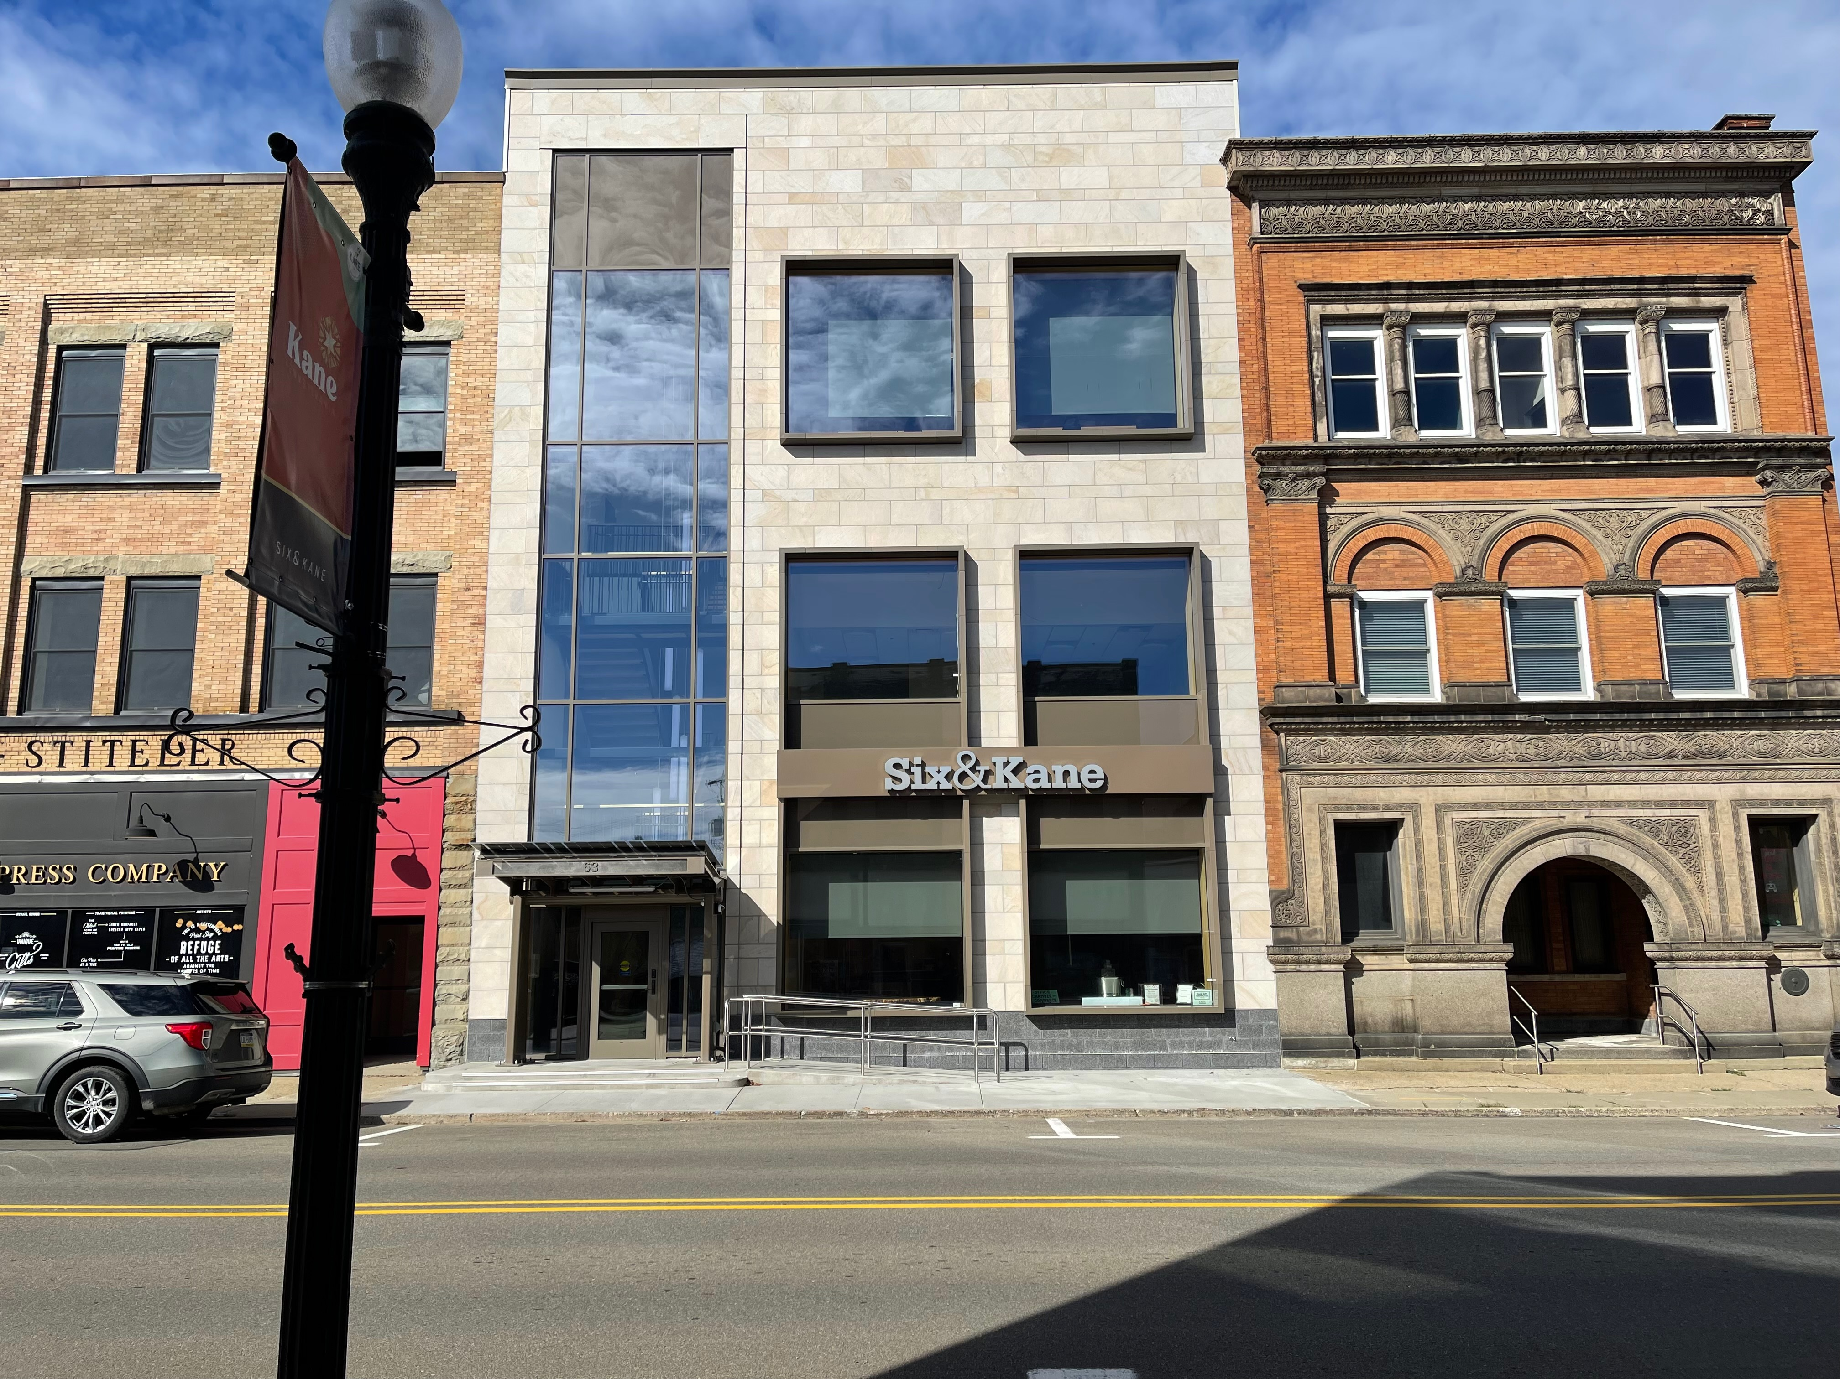
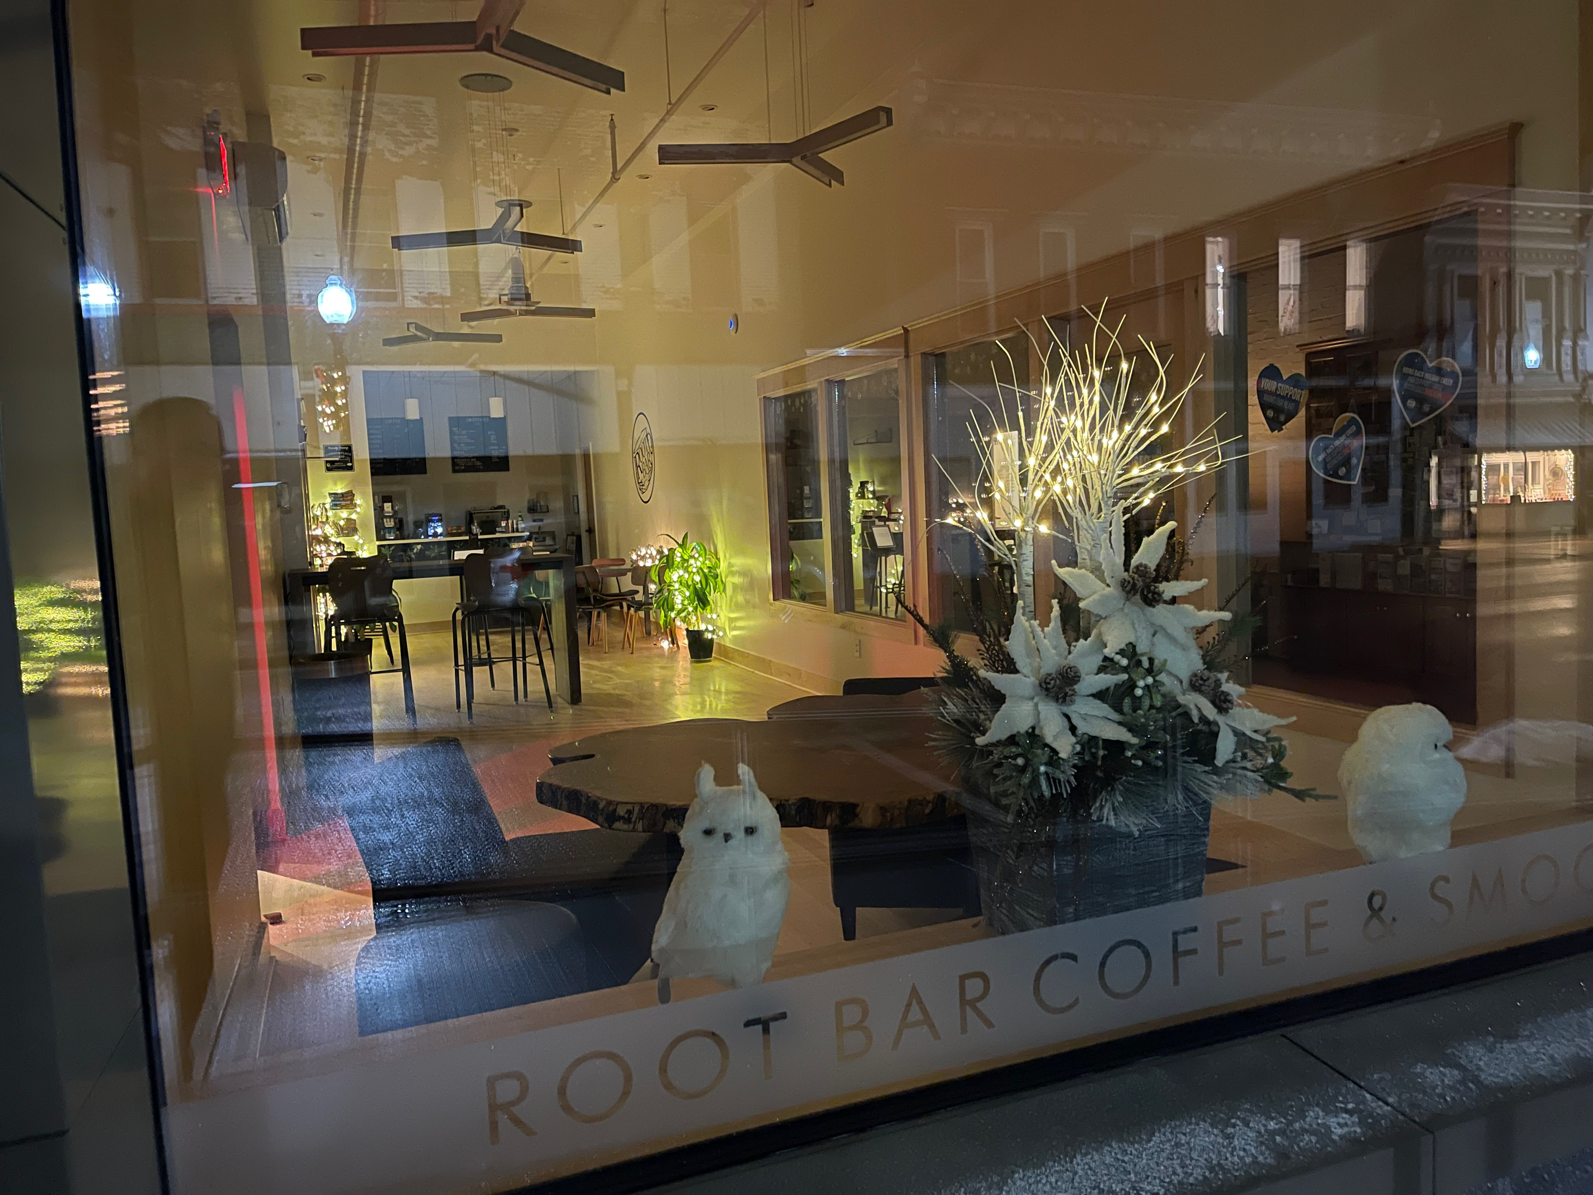
Rebirth of 63 North Fraley

Slide 9
Wesley Family Services
Quality Whole Community Care
Constructed 2020
Mixed building use,
36 apartments, affordable housing
Commercial office space for WFS
Passive House, LEED Gold certified, solar ready
Solar PV (104 DC, kW)
Energized: Jan 18, 2024, Dedicated Feb 22, 2024

Slide 10
